Slide 1


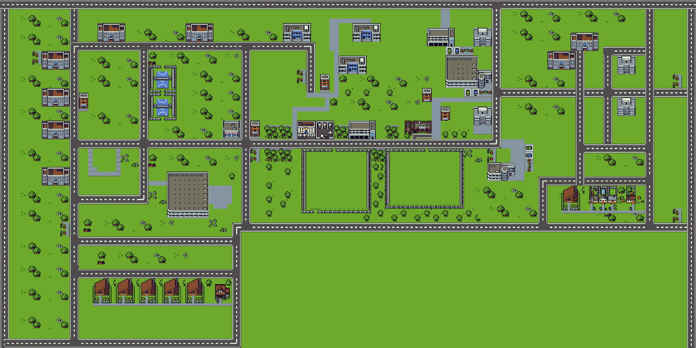
SURVIVE IITD
A 2-player game

Slide 2
About the Game
This is a 2 player game based on IIT Delhi Campus. In this game you will find various kinds of tasks which you can do. But, why should you even do tasks?? The reason for doing tasks is to maintain 3 most important parameters for your survival in IITD, your Health, CG and Money. Apart from this you can also enable Power-ups (at YULU stands) and then collide with the opponent at high speed to decrease their health. Further, there are various features like a Minimap , an Info sheet displaying the tasks left to be done and also you could even send an emoji/ message to your opponent while you are playing. Games like tic-tac-toe can be played within the game itself ; )
Disclaimer: There is much more to explore than what is described !

Slide 3





Rules of the Game
The player moves using the 4 arrow keys.
Various Tasks are kept at different buildings different types of tasks offer different benefits. Obviously if you do a task, for some time you cannot do anything.
CG Task
Money Task
Food Task
Hostel Task
The roads have points on them which will get you money
Remember , there is a timer of 3 minutes running for you to move around and do the tasks.
As you move around, your health and money decrease so you need to do tasks to maintain them.

Slide 4


Rules of the Game
There are also street dogs and if you collide with one you end up in the Hospital.
You get Power-ups at various Yulu stands which increase your speed and more importantly try colliding with other player with power up enabled :)
Your aim is to play optimally and maintain the 3 most important parameters to survive in IITD, your Health, CG and money.
The player who has all the 3 things balanced wins the game.

Slide 5
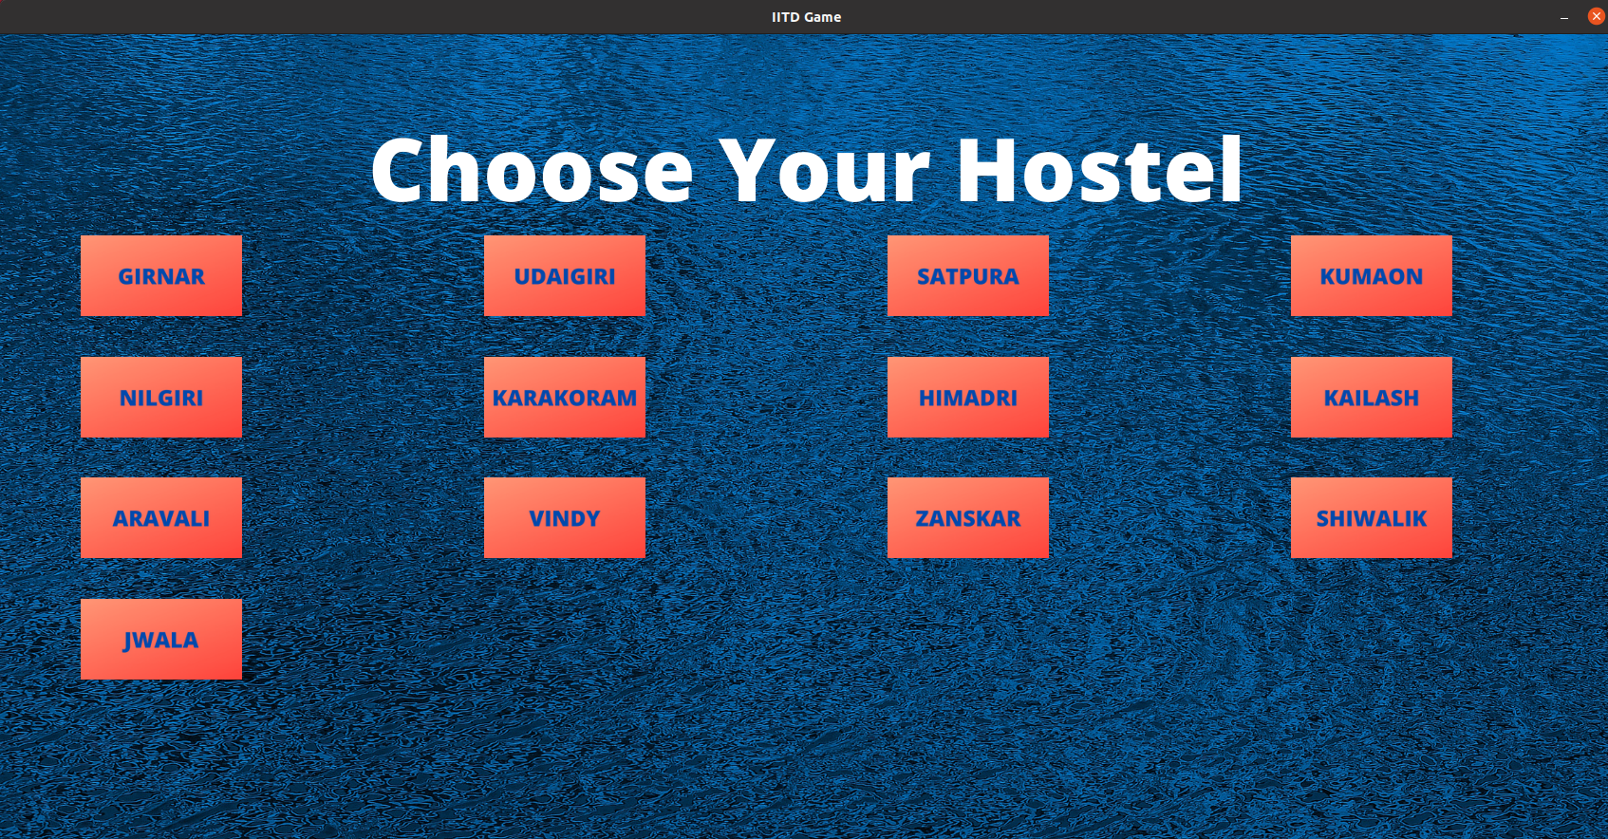
Features of The Game
You can choose whichever hostel you want to start your game at. This way it gives a personal touch to the player.

Slide 6
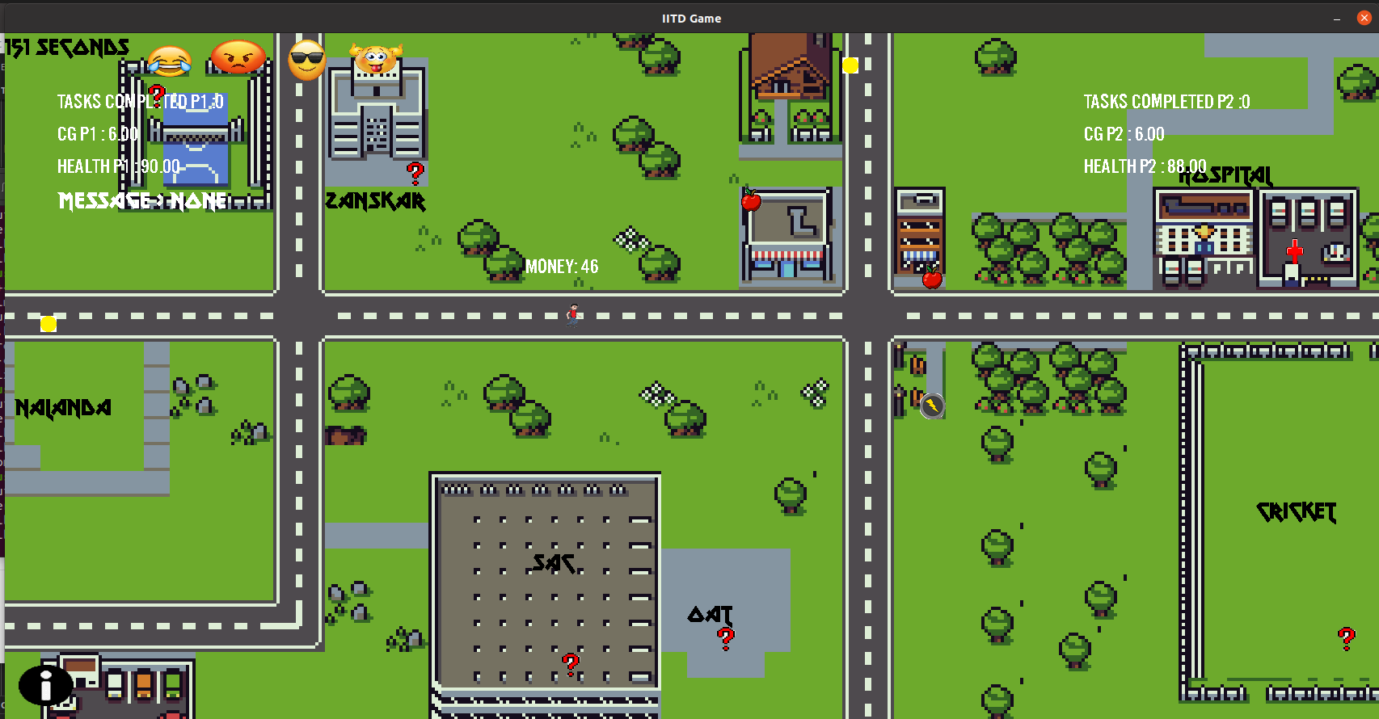
2. A player can see both his/her stats(health,money and CG) as well the
stats of the opponent. Further, he/she can see real time message sent by
their opponent also. Your stats are shown on top-left corner and your
opponent’s on the top-right corner. Keep an eye on them while playing.

Slide 7
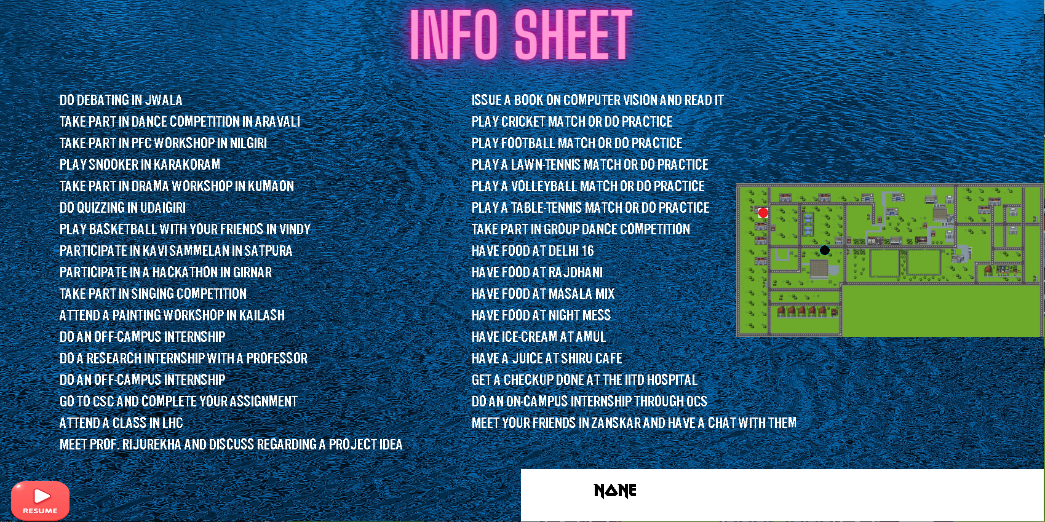
3. There is an Info button on the map which if you click opens up an Info
sheet and here you can see all the tasks left to be done. Further a
Minimap is also shown which shows the real-time positions of the players
moving around. Also, you can chat real time with the other player
through the white textbox shown in this screenshot.

Slide 8
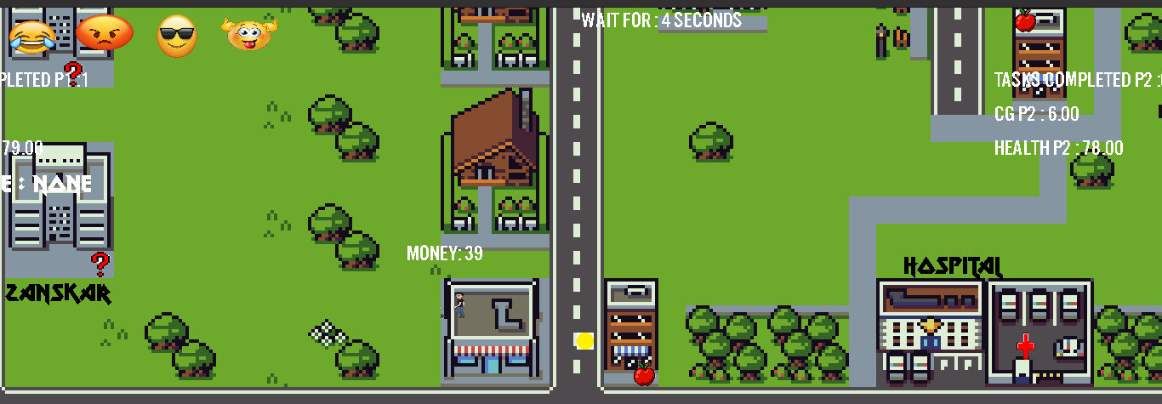
4. You have various tasks which offer different things. Try to complete them
before your opponent does it. After you reach a task you will see a
wait-time rendered above. Wait for the given time then move on to the
next task.

Slide 9
5. Send Emoji to the other player while playing.
6. You could also go to SAC and press 2 to play a Tic-Tac-Toe game. This will
earn you some money and health if you win. ( Press 1 to play snake game
which is under construction )
7. After the game ends you could also play a one player ping-pong match if
you like.
Hope You Enjoy Playing it
By - Kushagra Rode and Akarsh Jain

